Slide 1
Hardware / Software Co-Design
with a LEGO car WS
2013/1014
Poor - Man’s - Laser - Car

Slide 2
current state
- driving
- steering
- obstacle recognition

Slide 3
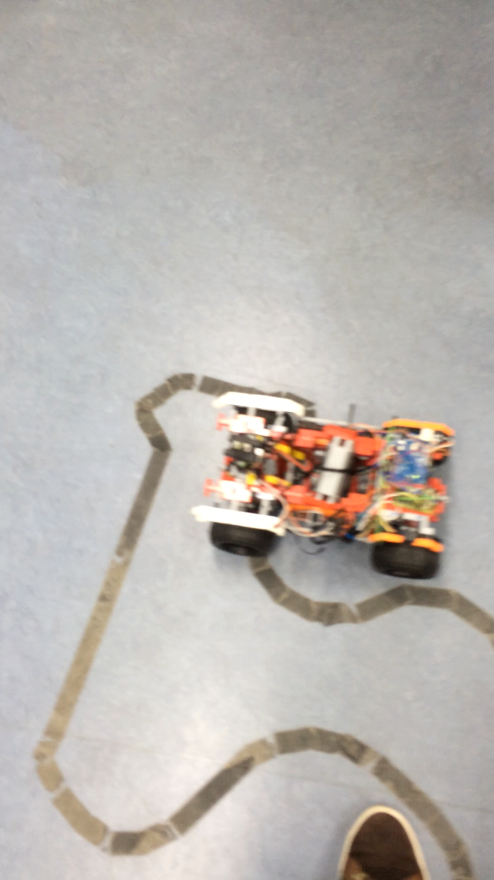

Slide 4
problems
- unprecise sensor data
- communication with WiFly device

Slide 5
plans
- obstacle avoidance
- wifi connection
- control with android app

